Slide 1
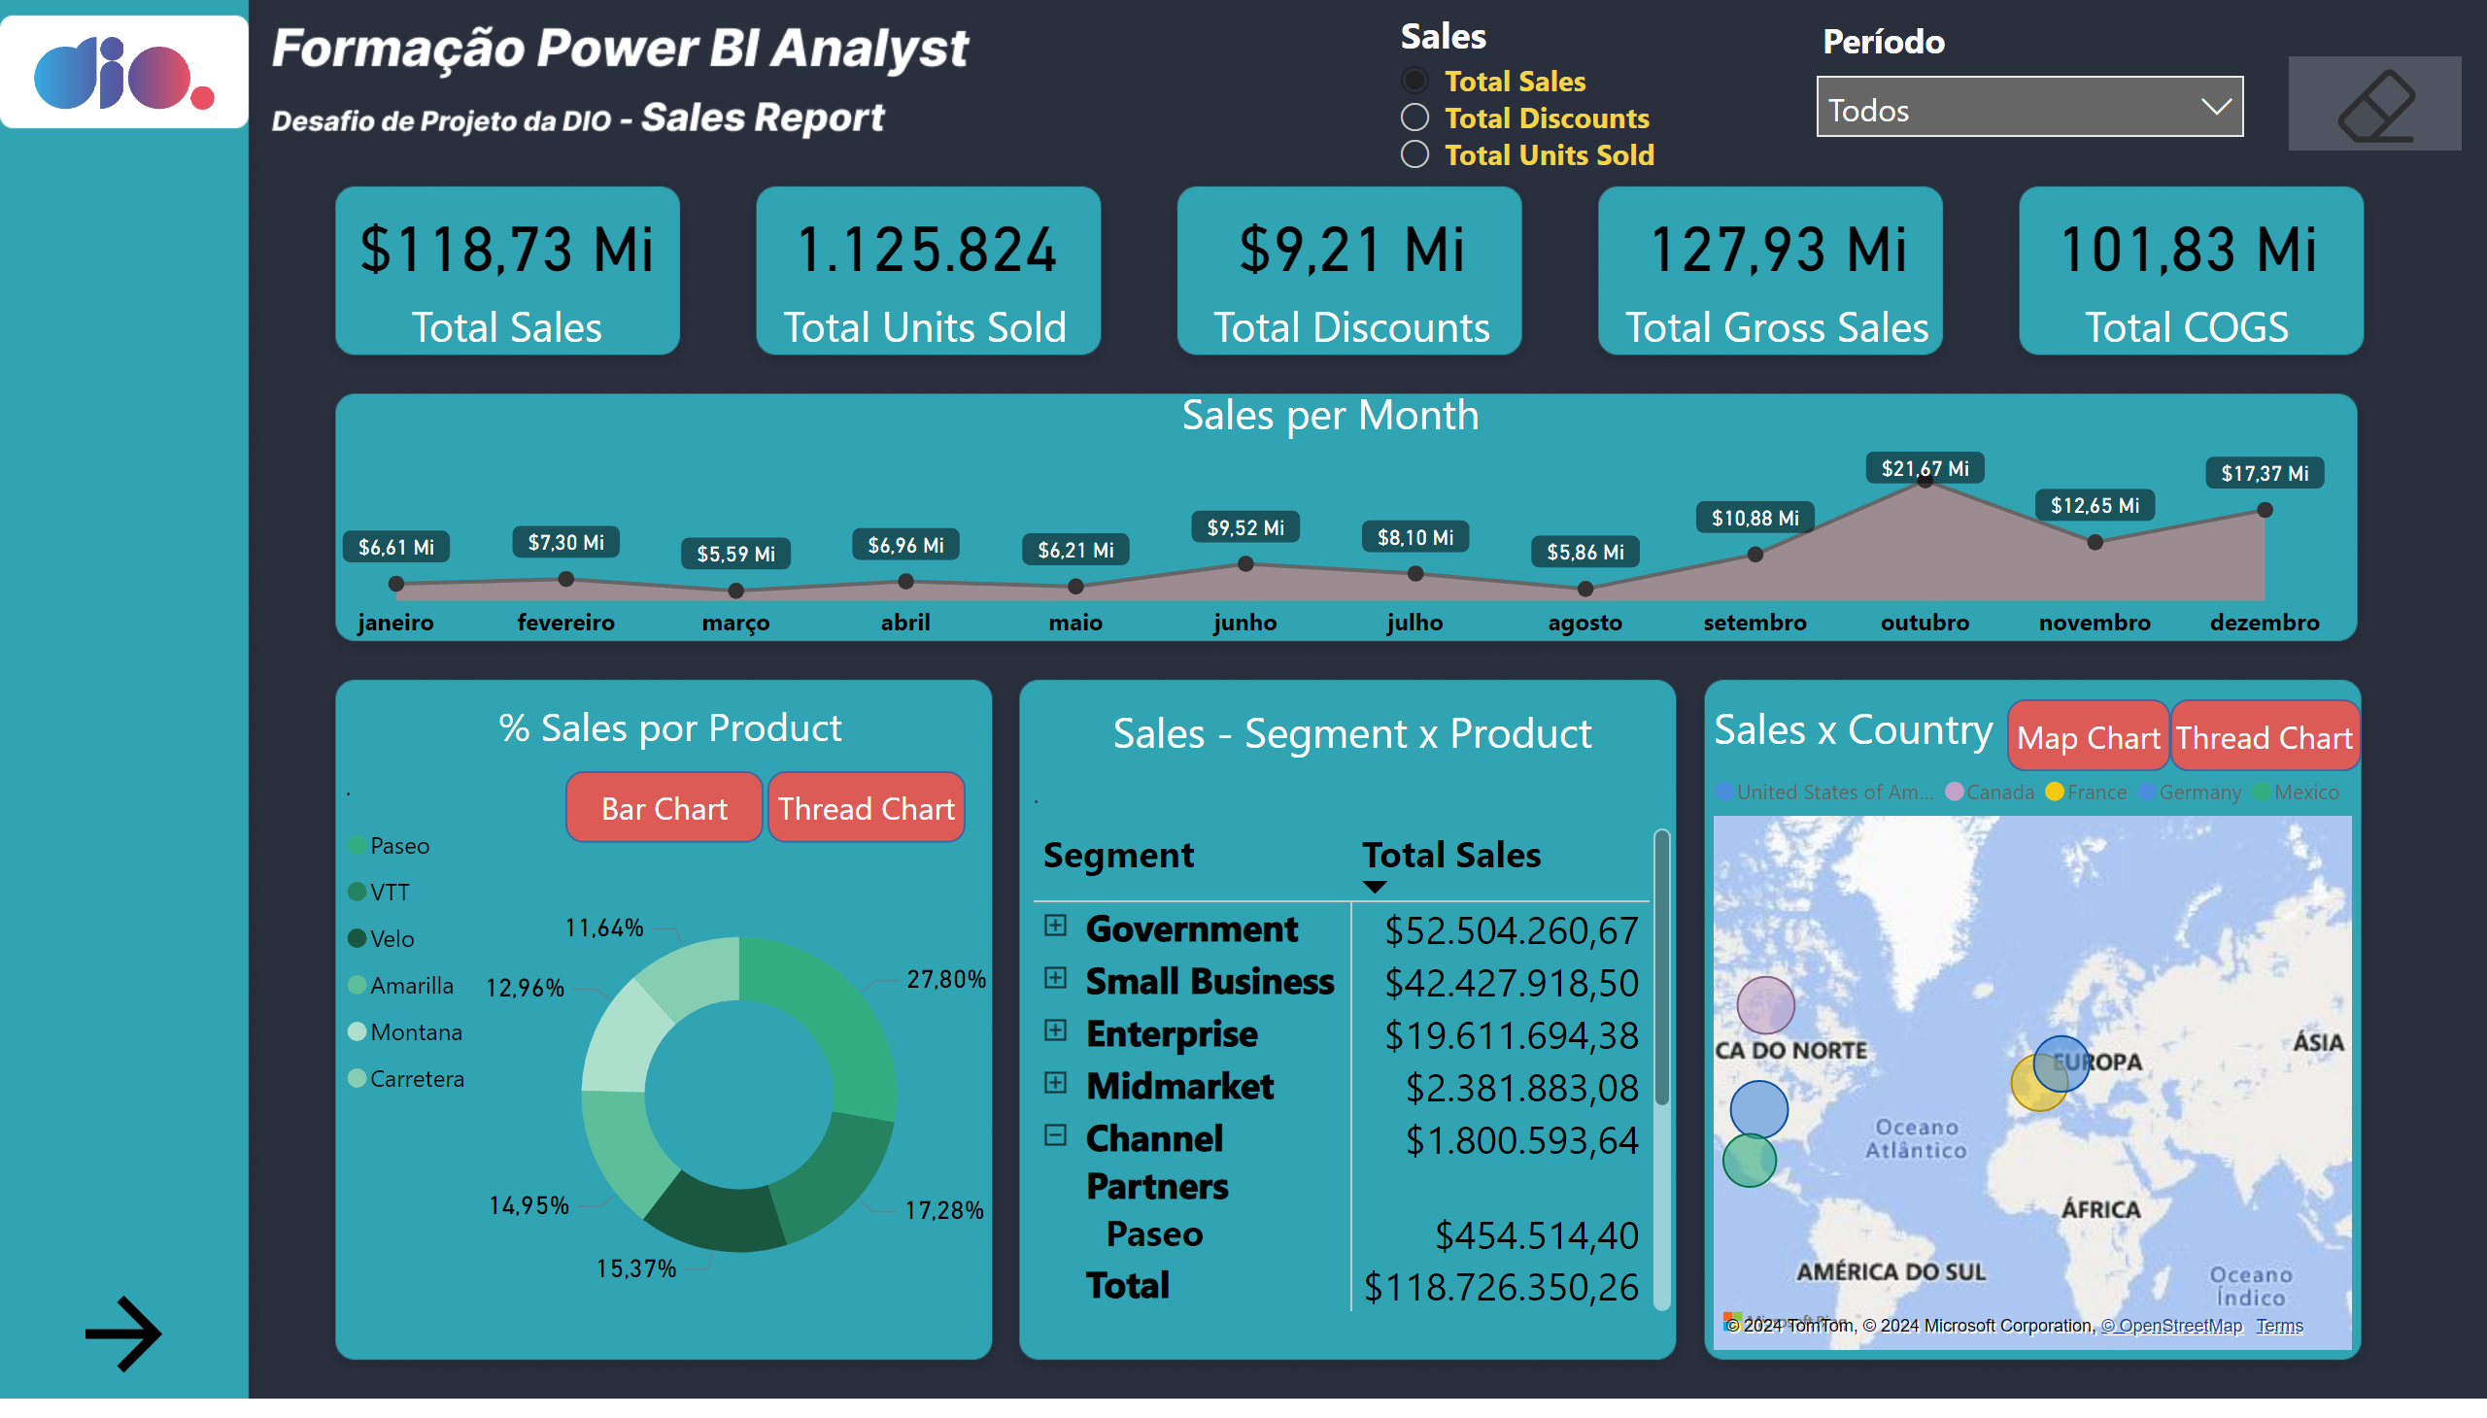
Página 1
Notes:
Dio
No alt text provided
slicer
No alt text provided
actionButton
No alt text provided
image
No alt text provided
slicer
No alt text provided
Sales - Segment x Product
No alt text provided
card
No alt text provided
card
No alt text provided
card
No alt text provided
card
No alt text provided
card
No alt text provided
Seta
No alt text provided
Sales per Month
No alt text provided
clusteredBarChart
No alt text provided
Sales x Country
No alt text provided
% Sales por Product
No alt text provided
Barchart
No alt text provided
Threadchart
No alt text provided
Barchart
No alt text provided
Barchart
No alt text provided

Slide 2
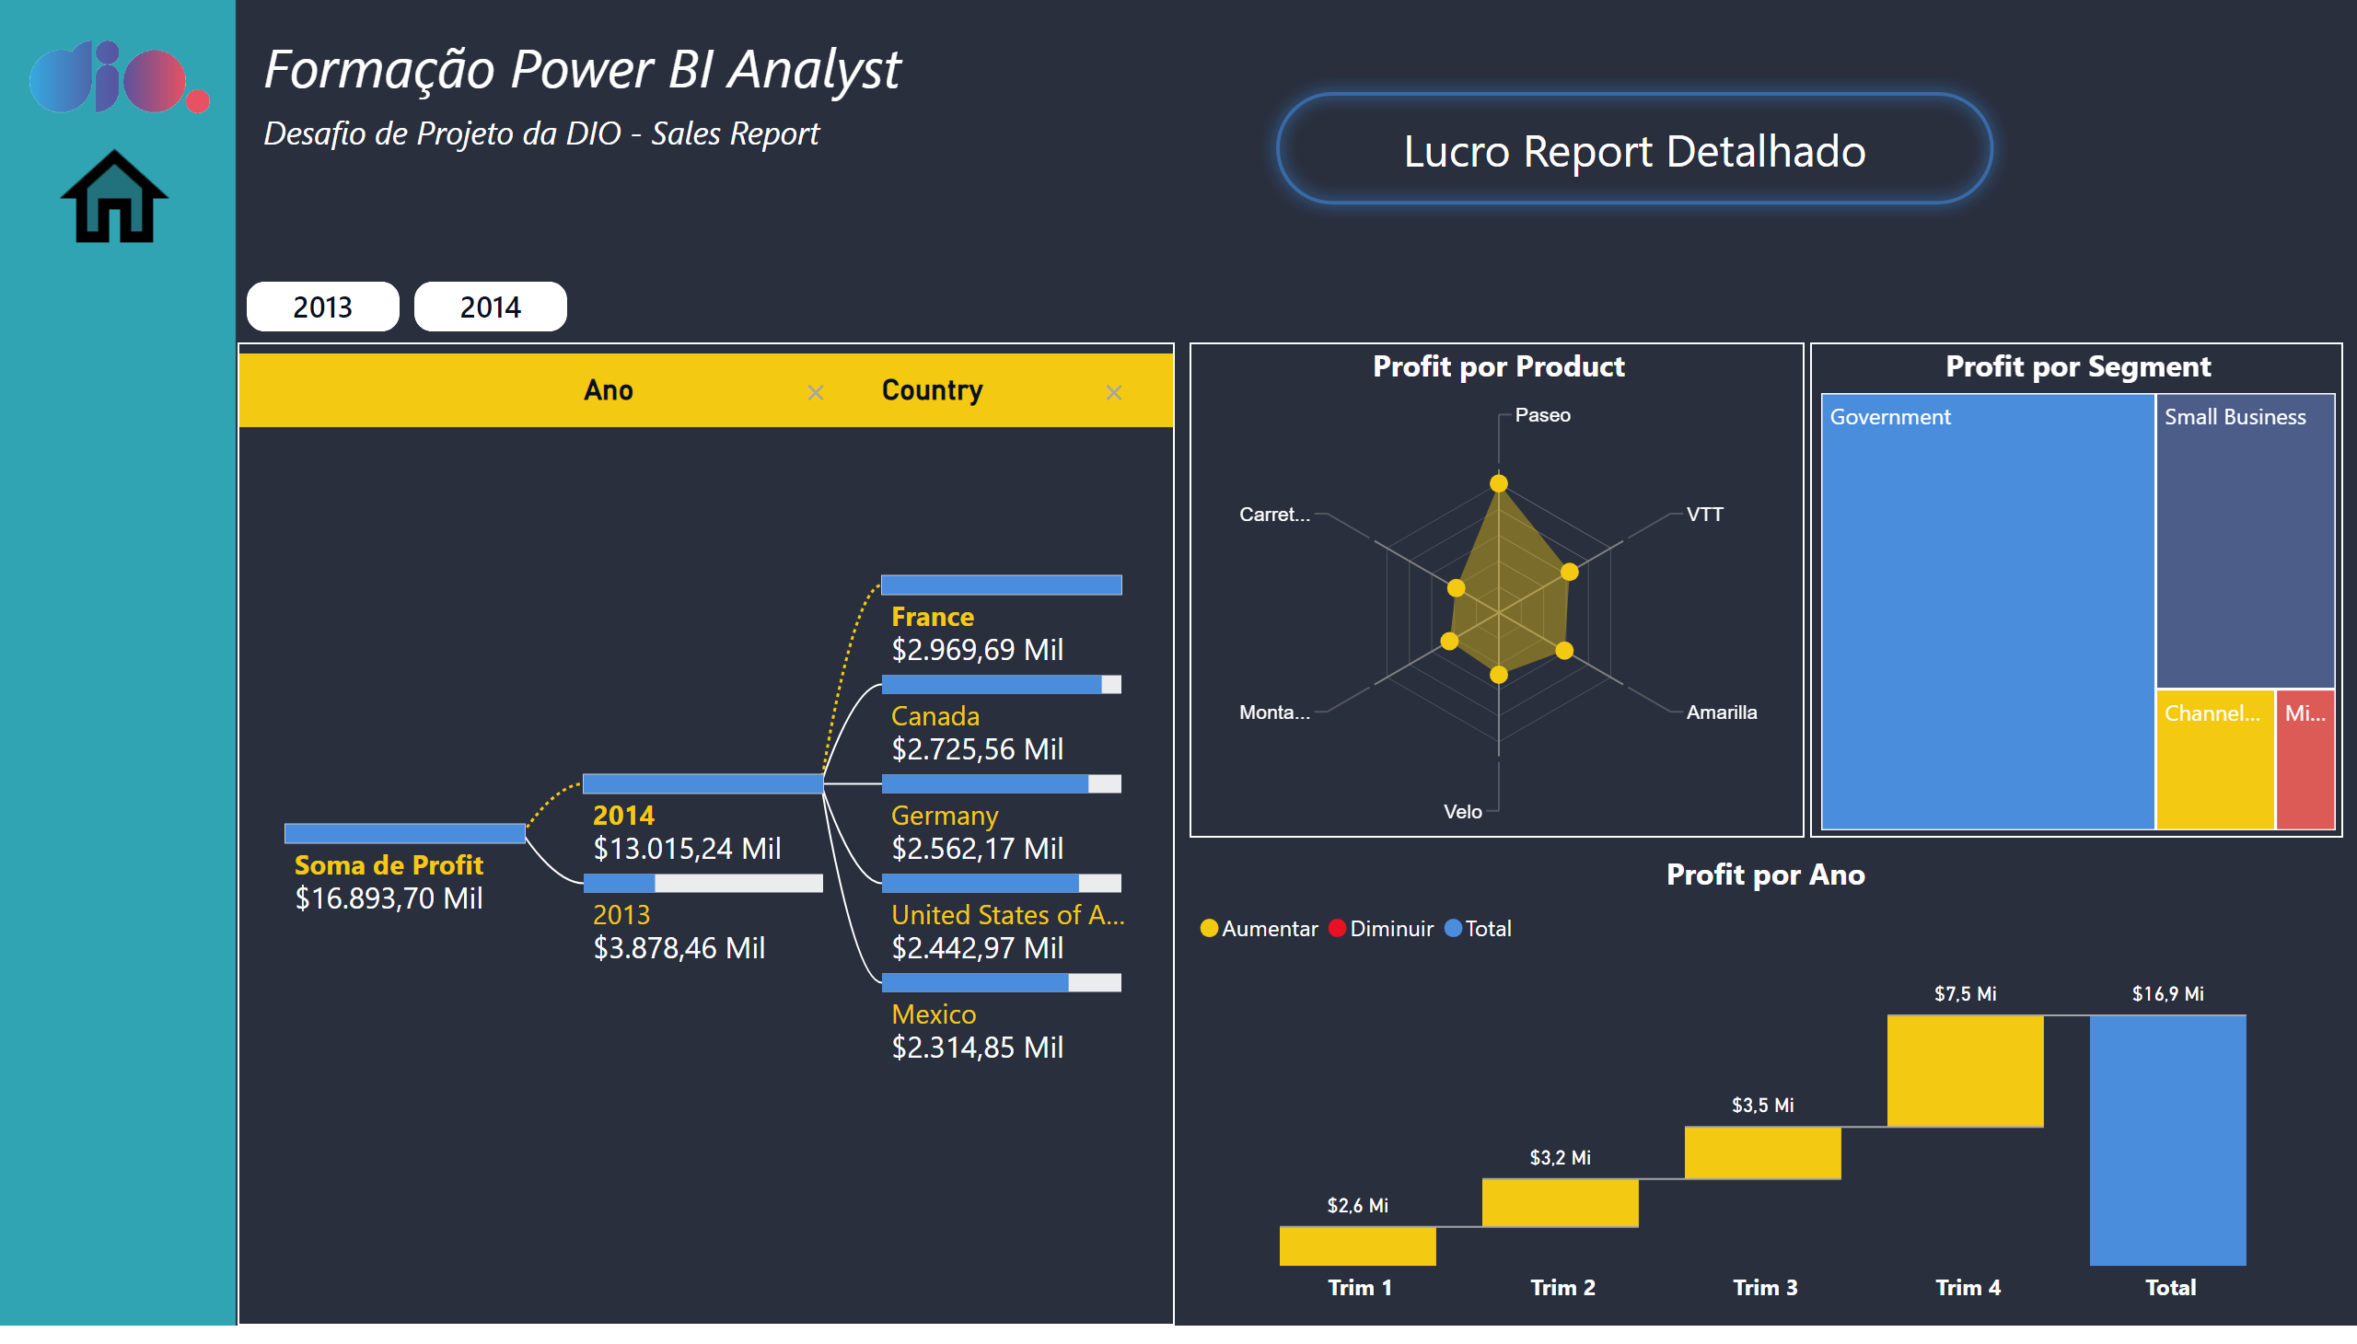
Página 3
Notes:
image
No alt text provided
Formação Power BI Analyst
No alt text provided
image
No alt text provided
shape
No alt text provided
decompositionTreeVisual
No alt text provided
advancedSlicerVisual
No alt text provided
Profit por Product
No alt text provided
Profit por Ano
No alt text provided
Profit por Segment
No alt text provided

Slide 3
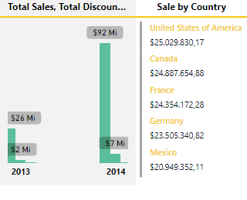
Tooltip
Notes:
clusteredColumnChart
No alt text provided
Sale by Country
No alt text provided

